Slide 1
Breakdown of human outcomes
Human
Outcomes¹
Character & Values
Life skills
Competencies & Future Skills
Akhlaq (respect, integrity, etc.)
Ambition
Grit & resilience
Humanity (empathy, societal & cultural awareness, etc.)
National identity
Healthy
Financial literacy & time management
Emotional intelligence
Practical life management
Critical thinking
Creativity & imagination
Adaptability
Digital & AI fluency
Entrepreneurship
Collaborative
Communication
Akhlaq: Behaving ethically and with kindness, respect, and integrity
Healthy: Maintaining physical, mental, and emotional health and well-being
Critical thinking: Evaluating information to think logically and make reasoned decisions
Ambition: Setting and pursuing meaningful goals and passions with purpose
Financial literacy & time management: Managing money and time responsibly to achieve goals
Creativity & imagination: Developing original and innovative ideas and solutions
Grit & resilience: Persisting through challenges and having determination
Emotional intelligence: Recognizing, regulating, and managing emotions to support growth & relationships
Adaptability: Adjusting to new or uncertain situations, challenges, and environments with agility
Details
Humanity: Being societally and culturally aware, valuing diversity and showing empathy for others
Practical life management: Learning & applying everyday skills for independence, survival & problem-solving (e.g., cooking, laundry, fixing a light, etc.)
Digital & AI fluency: Using technology & AI confidently & responsibly to learn, work, and problem-solve
National identity: Having pride in, embodying, and contributing positively to the UAE in alignment with National Identity pillars; Language, Values, Watan, Culture & Traditions, History
Entrepreneurship: Transforming ideas into real-world opportunities and solutions
Collaborative: Working effectively and respectfully with others to achieve goals
Communication: Expressing ideas clearly and effectively and listening actively, interpersonal and intrapersonal skills
Character Qualities
Foundational Literacies
Competencies
WEF 21st Century Skills
Initiative
Persistence/ grit
Leadership
Curiosity
Social & cultural awareness
Adaptability
Literacy
Numeracy
Scientific literacy
ICT (digital) literacy
Financial literacy
Cultural & civic literacy
Critical thinking & problem-solving
Creativity
Collaboration
Communication

Slide 2

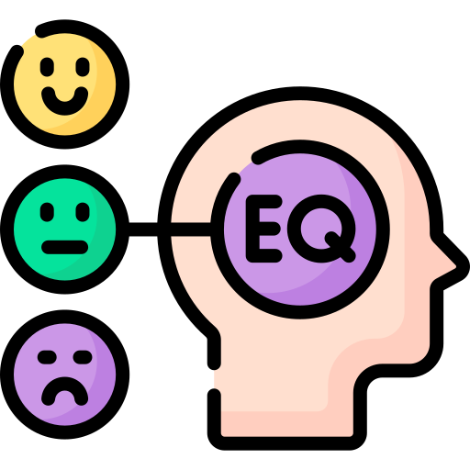



To reach future-proof workforce: Life readiness
3
Measuring life readiness from cradle to career
Proposed pillars
Cognitive Mastery
Core literacies, critical thinking, and learning agility
Social-Emotional Intelligence
Self-awareness, relationship skills, and emotional regulation
Physical & Mental Wellness
Health literacy, resilience, and well-being practices
Economic & Financial Capability
Resource management, career navigation, and value creation
Civic & Digital Participation
Responsible engagement in communities and digital ecosystems
Age breakdown
Ages 3–10 (Foundation Building)
Reading fluency
Mathematical reasoning
Ability to form peer relationships & self‑regulate
Physical coordination & healthy habits
Ages 11–17 (Exploration & Identity Formation)
Problem‑solving & self‑directed learning
Healthy peer relationships
Understanding work‑learning pathways
Responsible behavior & civic awareness
Ages 18–25 (Early Independence)
Professional/technical competency & adaptability
Workplace collaboration
Health & wellness routines
Emergency savings & credit literacy
Ages 56–64 (Redefining & Contributing)
Advisory/teaching roles & knowledge preservation
Relationship depth & life satisfaction
Functional independence
Volunteer impact & digital inclusion
Ages 41–55 (Sustaining & Transitioning)
Family harmony
Chronic‑condition management
Life satisfaction
Retirement adequacy
Community impact
Ages 26–40 (Building & Establishing)
Career progression
Relationship stability
Regular health screenings
Retirement savings and potential homeownership
12/14
Surveys? Yes — socio‑emotional skills questionnaires are explicitly listed. ✔︎
Quantitative data? The document names indicator categories but does not define specific quantitative measures, scales, scoring rules, or targets — missing.

